Slide 1
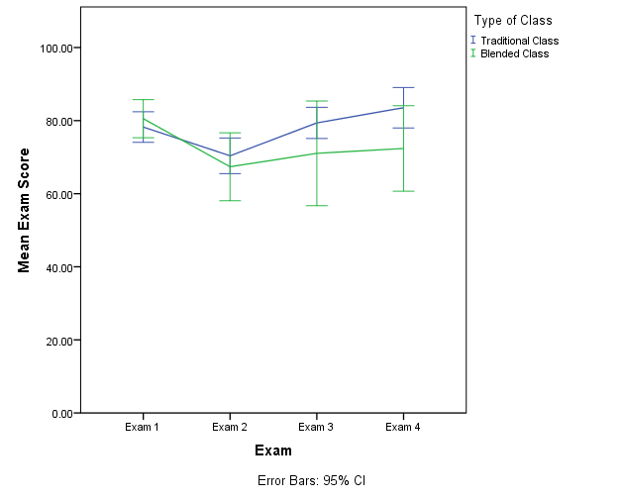
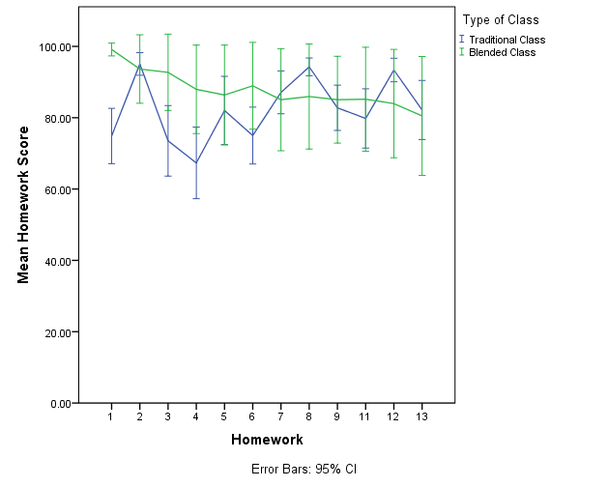
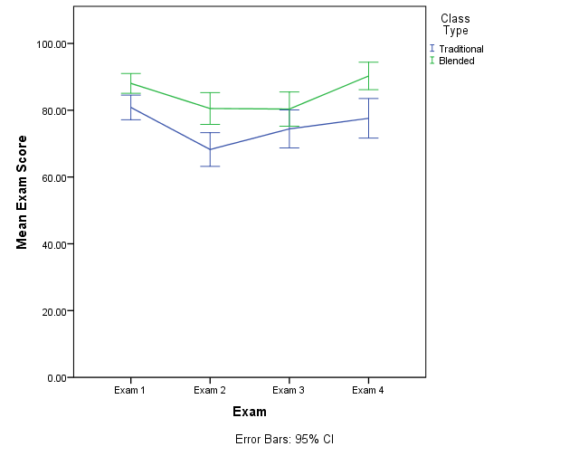
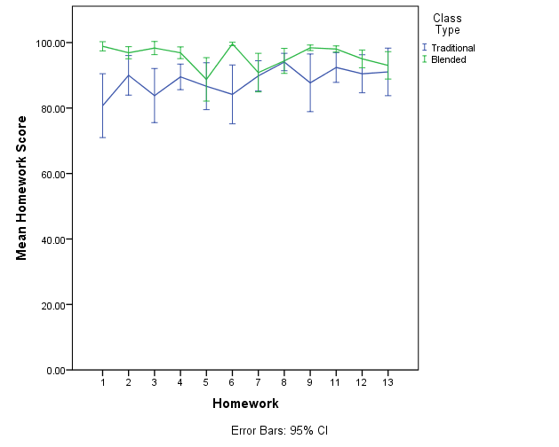
Shaking Up Statistics: A Blended Learning Perspective
My Vu, Erin M. Buchanan, Kayla Jordan, Marilee Teasley, Kathrene Valentine
Missouri State University
Introduction
Why should we care about new methods of teaching statistics?
Retention of material is often poor (Lyle, 2011).
Today’s student may approach learning in new ways (Dziuban, Moskal, & Hartman, 2005).
What are the challenges to teaching a statistics class?
Students vary in their ability, motivation, and assertiveness (Perkins, 2001).
Since students have a low level of interest and lack preparation, students exhibit math anxiety (Wilson, 2013).
What are some techniques to solve possible problems?
Application exercises not only show the relevance of the subject but its repeated practice helps retention (Perkins, 2011).
Group work keep students actively engaged in the learning process (Wilson, 2013).
Blended learning is the combination of classroom face-to-face learning experiences with online learning experiences.
Advantages of Blended Learning
It satisfies social interactions while maintaining its flexibility (Cottle, 2011).
Disadvantages of Blended Learning
It is time consuming for the teachers to create and update courses and it increases student’s responsibilities (Cottle, 2011).
Semester 1
Learning Objectives
Demographics | Blended | Traditional
Female (%) | 35% | 70.3%
Ethnicity (% Caucasian) | 80% | 83.8%
Credit Hours Completed M (SD) | 84.11 (36.53) | 77.01 (19.08)
Age M (SD) | 22.55 (5.92) | 20.86 (2.40)
Overall GPA M (SD) | 2.92 (0.61) | 3.25 (0.52)
 | Semester 1 |  |  | Semester 2
 | M Attempts | M Grade | M Time | M Attempts | M Grade | M Time
Descriptive Statistics | 1.08 | 76.35 | 0:09:01 | 1.35 | 77.25 | 0:05:59
Tables/Graphs | 1.00 | 100.00 | 0:18:47 | 1.21 | 87.21 | 0:07:48
Distributions | 1.15 | 79.40 | 0:09:02 | 1.27 | 83.00 | 0:04:21
Z-score | 1.25 | 77.82 | 0:12:13 | 1.48 | 76.43 | 0:06:50
Z-test | 1.08 | 46.63 | 0:32:59 | 1.33 | 64.93 | 0:16:06
Hypothesis Testing | 1.00 | 84.00 | 0:08:55 | 1.57 | 78.88 | 0:04:35
Confidence Intervals | 1.15 | 86.67 | 0:15:03 | 1.34 | 81.15 | 0:06:47
Power | 1.19 | 81.84 | 0:06:24 | 1.27 | 82.99 | 0:03:28
Single Sample t test | 1.40 | 61.29 | 0:38:49 | 1.38 | 65.61 | 0:12:15
Dependent t test | 1.38 | 50.53 | 0:31:00 | 1.48 | 70.76 | 0:04:43
Independent t test | 1.20 | 72.34 | 0:26:29 | 1.21 | 74.75 | 0:04:54
ANOVA | 1.15 | 79.55 | 0:13:18 | 1.21 | 73.03 | 0:04:17
Correlation | 1.04 | 87.16 | 0:16:43 | 1.10 | 87.66 | 0:07:09
Regression | 1.00 | 81.50 | 0:14:26 | 1.14 | 80.79 | 0:08:55
Chi-square test | 1.38 | 57.86 | 0:34:26 | 1.13 | 60.66 | 0:17:34
Interaction Effect: F (3, 165) = 3.274, p = .023, partial η² = .056
Interaction Effect: F (3, 165) = 5.012, p < .001, partial η² = .084
Semester 2
Demographics | Blended | Traditional
Female (%) | 63.3% | 67.5%
Ethnicity (% Caucasian) | 81.6% | 87.5%
Credit Hours Completed M (SD) | 86.08 (26.13) | 63.95 (27.69)
Age M (SD) | 22.06 (4.94) | 20.73 (2.21)
Overall GPA M (SD) | 3.40 (0.54) | 3.00 (0.68)
Method
Semester 1 (Spring)
Blended section: 20 students
Traditional section: 37 students
Semester 2 (Fall)
Blended sections: 49 students
Traditional sections: 43 students
Instructors
Blended sections taught by full-time faculty member
Traditional sections taught by adjunct faculty trained by full time faculty member
Materials
Textbook: Aron, Aron, and Coups (2012) Statistics for the Behavioral Sciences
Blended component: MyStatLab portal offered in conjunction with this textbook.
Assessments
Chapter quizzes (12-20)
Homework Assignments (12)
Exams (4)
The courses were presented on the same course schedule. In the blended section, homeworks and quizzes could be taken several times for full credit (with different items each time).
Discussion
Compared to traditional sections, the blended course shows better exam grades, but only in the second semester.
Homework grades are better than traditional classes because of the ability to practice with multiple attempts, and standard deviations for homework grades decreased with the second semester.
Blended sections of statistics showed improvement with instructor experience, as the second semester portrayed better learning outcomes and grades than the first semester of blended sections.
With the blended system, topics can be examined by specific learning objectives to target difficult concepts for future implementations.
Contact
My Vu (my03@missouristate.edu)
Erin Buchanan (erinbuchanan@missouristate.edu)
Kayla Jordan (jordan810@live.missouristate.edu)
Marilee Teasley (teasley888@live.missouristate.edu)
Kathrene Valentine (valentine3@live.missouristate.edu)
Interaction Effect: F (3, 255) = 1.89, p = .132, partial η² = .02
Main Effect of Exam: F (3, 255) = 5.26, p = .002, partial η² = .06
Interaction Effect: F (6.81, 449.27) = 4.13, p < .001, partial η² = .06
*Two big drops in blended sections are introductions to hypothesis testing.

